Slide 1
Skin Cancer in Solid Organ Transplant Recipients
Presenter:
Dr Aaron Fredericks
Dermatology trainee
Slides prepared by:
Dr Liang Jong
Service Dermatology Registrar

Slide 2
Objectives
Recognise different types of skin cancer
Pre-cancerous skin lesions
Non-melanoma skin cancer - SCC, BCC
Melanoma
Skin cancer in transplant recipients
Brief overview of treatment and management of skin cancer

Slide 3
Why is this important?
Immunosuppression significantly increases the risk of non-melanoma and melanoma skin cancer (65x risk)
High rates of multiple skin cancers
Higher rates of rarer skin cancers eg Merkel cell cancer
High rate of skin cancer-related deaths (estimated at 10-100x risk in non-immunosuppressed
Cardiac/lung > Kidney > Liver > Bone marrow
JAMA 2022 Nov;158(11):1287-1292

Slide 4
When to suspect skin cancer?
New, rapidly growing lesion
Lesion that changes in appearance – colour, size
Non-healing old lesion
Pain
Bleeding

Slide 5
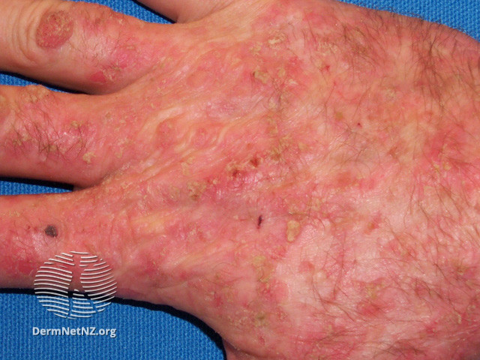
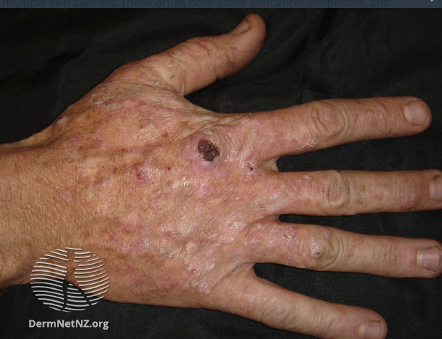
Actinic keratoses (AK)– pre- cancerous lesions
Pre-cancerous
Actinic keratosis
SCC
UV exposure
Caused by sun damage.
Pre-cancerous, risk of developing into SCC
Features:
Red and scaly
Red, thick or crust
Smooth and red
Sticking up, pointed and hard like fingernail
** Photos are from DermNet.
Notes:
It is estimated that the likelihood that a given AK will evolve into an invasive SCC is approximately 0.075%-0.096% per lesion, in general population. Source: visualdx

Slide 6
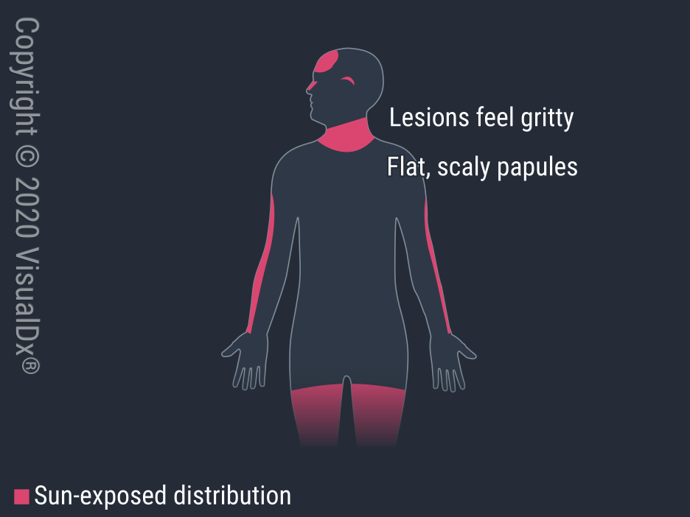
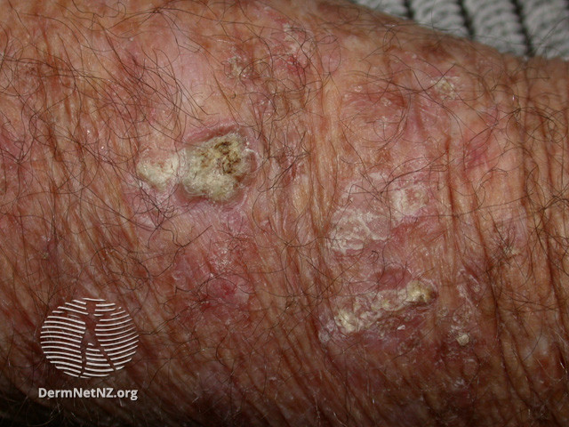
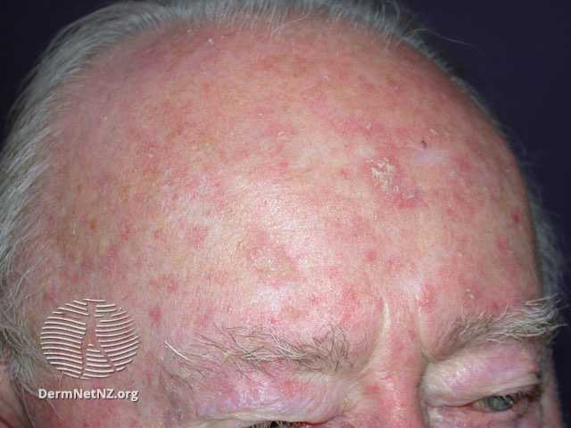
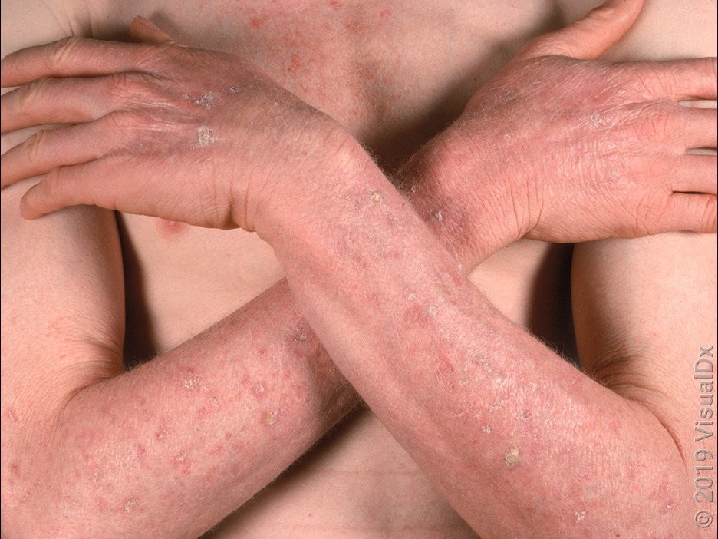
Actinic keratoses (AK) – cont’
More common in older people due to increased sun exposure.
Common places – sun exposed areas – scalp (bald/thinning hair), face, side of neck, backs of hands/forearms, legs or feet
Type of treatment depending on size, site, and the number of AKs.
Recommend more aggressive treatment in transplant pt
** Photos are from DermNet/VisualDx.

Slide 7
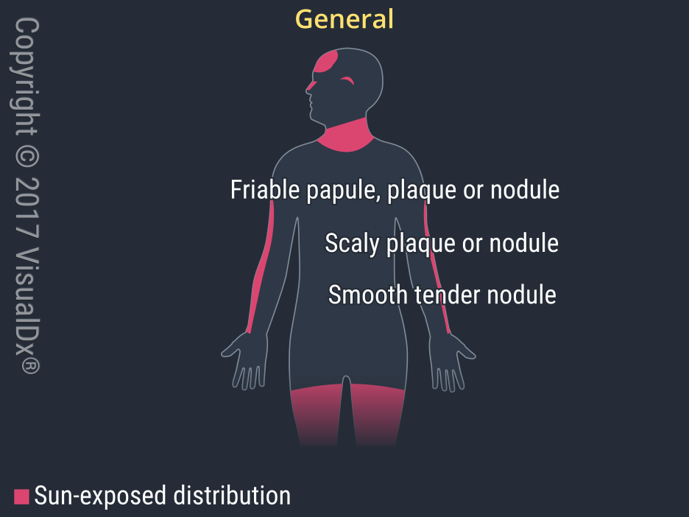
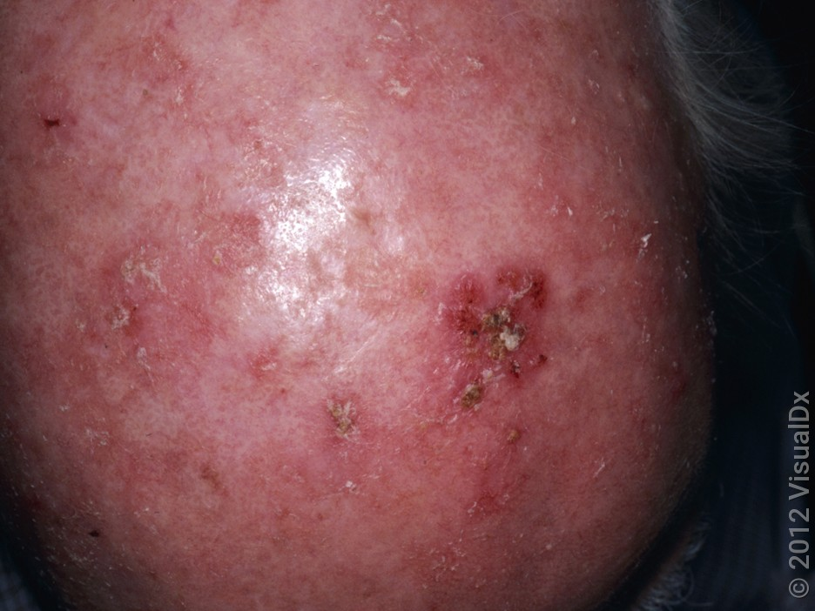
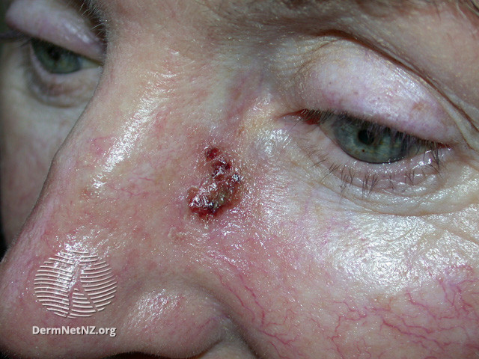
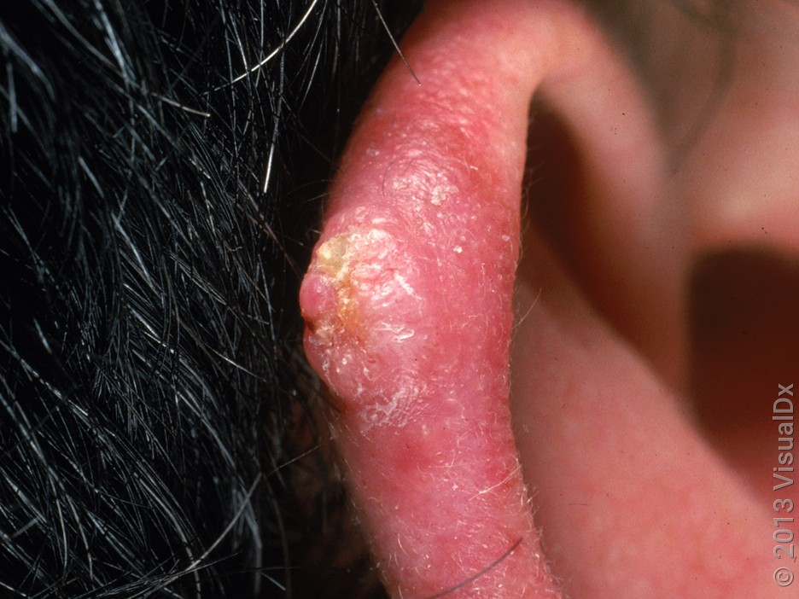
Cutaneous Squamous cell carcinoma (cSCC)
Most common type of skin cancer in transplant recipients
Features
Non-healing, raised, crusty sore or lump
Can be tender/may ulcerate
Can vary from few mm to several cm
Can grow rapidly within a few weeks
Can occur anywhere on the body, but more commonly on sun-exposed skin
** Photos are from DermNet/VisualDx.

Slide 8
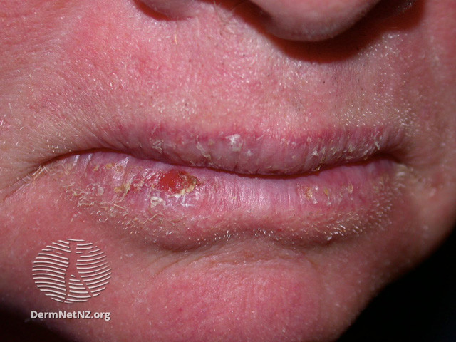
Cutaneous Squamous cell carcinoma (cSCC)-cont’
Increased rate of lip cancer in transplant pt
SCC can spread to lymph nodes (80%), lungs, liver, brain, bones and skin
Notes:
Lip cancer can also be seen with increased frequency among solid organ transplant recipients, but reasons are uncertain.
Source:
Risk of lip cancer after solid organ transplantation in the United States.AULaprise C, Cahoon EK, Lynch CF, Kahn AR, Copeland G, Gonsalves L, Madeleine MM, Pfeiffer RM, Engels EA SOAm J Transplant. 2019;19(1):227. Epub 2018 Sep 5.

Slide 9
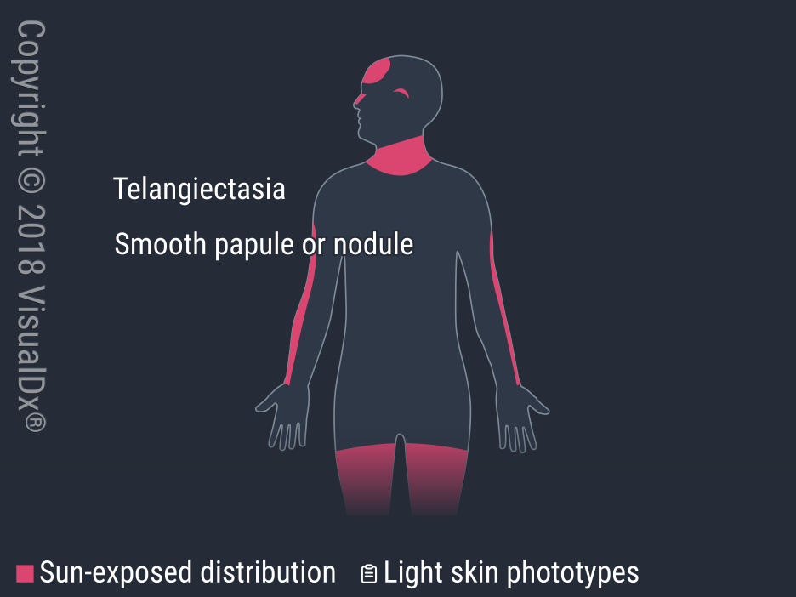
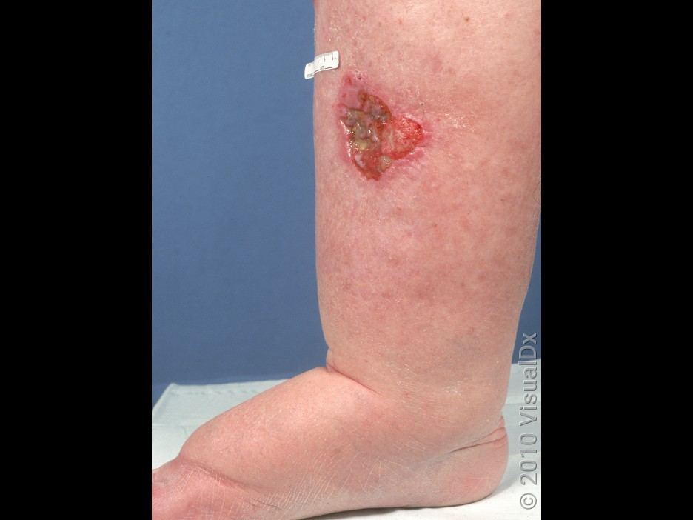
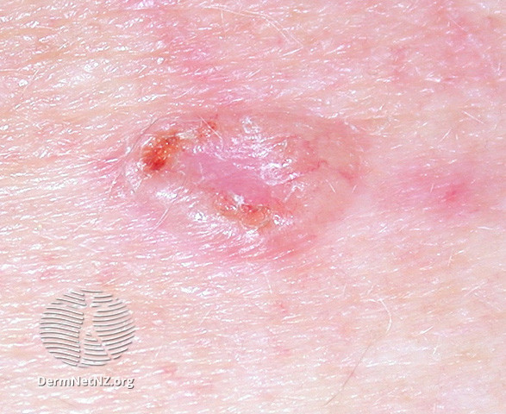
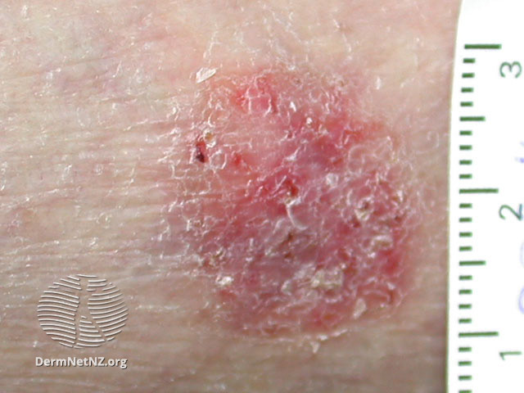
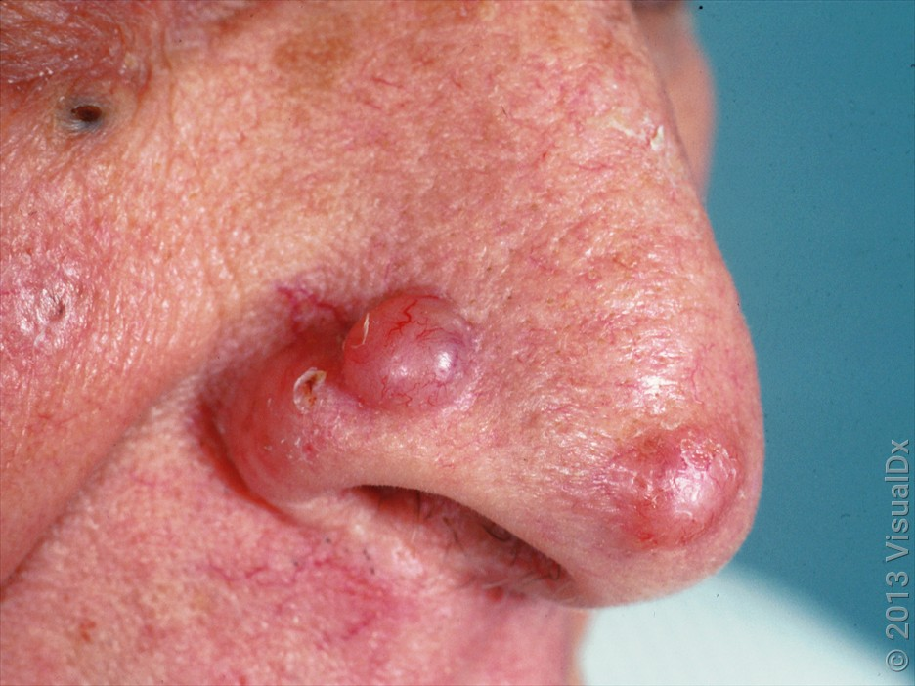
Basal cell carcinoma (BCC)
Most common type of skin cancer in general population.
Features:
Pale red/pearly smooth lump * often head and neck
Pink, scaly patches, * more on trunk and limbs
Slow growing
More common in sun exposed areas
Although BCCs are almost never fatal, local tissue destruction and disfiguration occur.
** Photos are from DermNet/VisualDx.

Slide 10
NMSCs – SCC and BCC in organ transplant recipients
In contrast to general population, SCC is more common than BCC in organ transplant recipients.
The estimated ratio of SCC to BCC in organ transplant patients range from 1.5:1 to 5:1.
Risk of developing SCC – 65-250 x more likely
Risk of developing BCC – 6-16 x more likely
Notes:
In contrast to the general population, in which the incidence of BCC exceeds that of cSCC, most estimates of the ratio of cSCC to BCC in organ transplant recipients range from 1.5:1 to 5:1.
Source: uptodate
https://www.uptodate.com/contents/epidemiology-and-risk-factors-for-skin-cancer-in-solid-organ-transplant-recipients?search=skin%20cancer&source=search_result&selectedTitle=6~150&usage_type=default&display_rank=6#H7860393

Slide 11
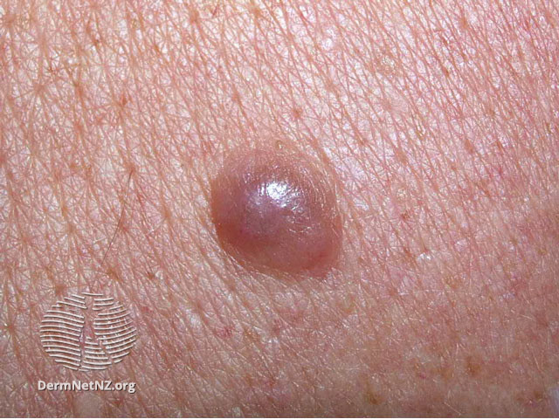
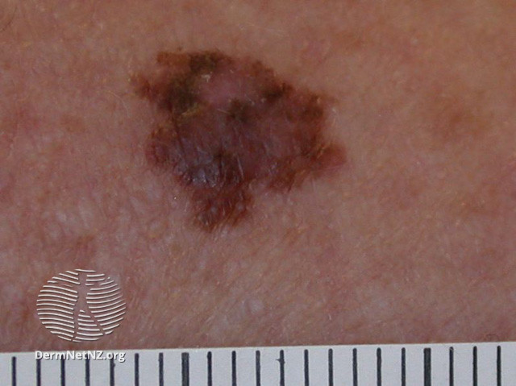
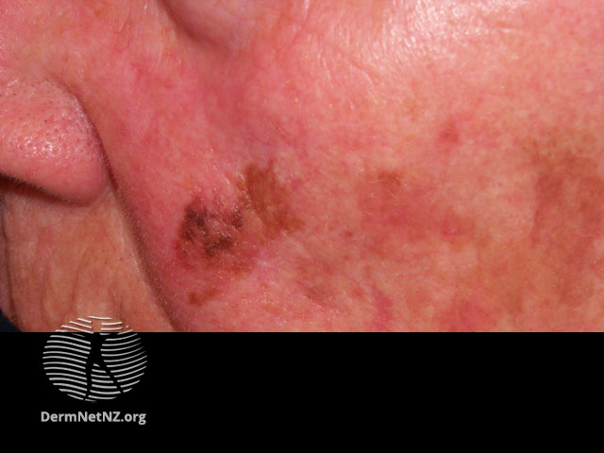
Melanoma ‘Unusual looking mole’
Potentially very serious skin ca, which there is an uncontrolled growth of pigment cells.
Features – the ABCDE rule (see next slide)
New mole or freckle, or existing mole that is changing in shape or size
Irregular edges
Multiple colours within the spot
Can occur any where on skin, including back and hard-to-see areas eg inside mouth, genitals.
Can run in families
Nodular Melanoma
Superficial spreading
Lentigo Maligna melanoma

Slide 12
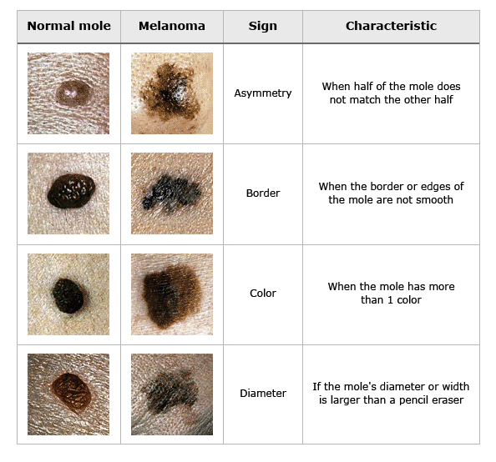
***source: uptodate

Slide 13
Melanoma in transplant recipients
Carries higher mortality
Based on the largest published investigation, risk of invasive melanoma was 2x general population
Risk was higher in renal transplant recipients than in liver and lung.
Notes:
The largest published investigation, a United States population-based study of 139,991 transplant recipients followed for a median period of four years, identified 519 patients with invasive melanoma and 190 with in situ melanoma (incidence rates 74 and 27.1 per 100,000 person-years, respectively) [54]. Incidence increased sharply in the first four years after transplantation before declining steadily. The risk of invasive melanoma was more than twofold higher than in the general population (standardized incidence ratio [SIR] 2.20, 95% CI 2.01-2.39). The greatest increase was noted for regional stage melanoma (SIR 4.11, 95% CI 3.27-5.09) and for melanomas on the head and neck (SIR 3.34, 95% CI 2.85-3.90). The risk was higher in renal transplant recipients than in liver and lung recipients. Other factors associated with increased risk included male sex, increasing age, and azathioprine maintenance therapy.
https://www.uptodate.com/contents/epidemiology-and-risk-factors-for-skin-cancer-in-solid-organ-transplant-recipients?search=skin%20cancer&source=search_result&selectedTitle=6~150&usage_type=default&display_rank=6#H7860400

Slide 14
Skin cancer in transplant recipients
Q1: Why are transplant recipients more prone to skin cancer?
A:
Long term immunosuppressants
impair the immune system’s ability to repair or destroy UV-damaged cells.
direct or contributory carcinogenic effects of the immunosuppressive medications eg Azathioprine or Cyclosporin.¹
proliferation of viruses that can cause cancer when the immune system is suppressed eg EBV, HPV (which can cause warts). ²
Notes:
Direct or contributory carcinogenic effects of immunosuppressive agents, such as azathioprine or cyclosporine [17]. Calcineurin inhibitors have been shown to impair cell ability to repair ultraviolet radiation-induced DNA damage via decreased transcription of xeroderma pigmentosum complementation groups A and G genes XPA and XPG, two components of the nucleotide excision repair system [18].
Proliferation of oncogenic viruses in the setting of immunosuppression. Epstein-Barr virus (EBV), human papillomavirus (HPV), Kaposi sarcoma herpes virus (KSHV), human T cell lymphotropic virus type 1 (HTLV-1), and Merkel cell polyomavirus (MCPyV) are the main viruses associated with the development of cancer in immunosuppressed patients.

Slide 15
Skin cancer in transplant recipients
Q2: How common is skin cancer in organ transplant recipients?
A:
Skin ca accounts for ~40% of cancer in adult transplant recipients.
It develops in ~50% of White transplant recipient; 6% in non-White patients.

Slide 16
Skin cancer in transplant recipients
Q3: Who is at highest risk of skin cancer?
A:
Patients who are on immunosuppressant meds for longer periods or at higher doses.
Old age
Had skin ca before transplant
Fair skin
Significant sun exposure
Virus infection eg HPV virus
Heart and lung transplant
Notes:
Heart and lung transplant recipients (who tend to have higher levels of immunosuppressant medication).

Slide 17
Skin cancer in transplant recipients
Q4: How quickly does skin cancer develop after organ transplant?
A:
There is usually a lag time of 3-7 years (source: international nurses transplant society)
This varies depending on individual risk factors.

Slide 18
Treatment/Management of skin cancer
Oral tablets
Skin creams
Surgery
Radiation therapy
Photodynamic therapy
Notes:
Will be focusing on oral and topical rx only as per JC’s email.
Skin cancer
- often very aggressive in transplant patients
- associated with high risks of mets and recurrence
Most skin cancers
- treated by surg excision or Mohs surgery

Slide 19
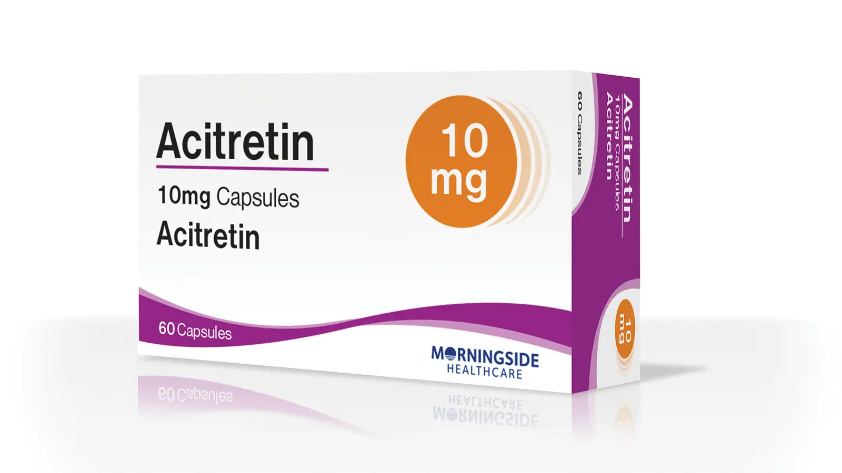
Prevention for non-melanoma skin cancer( NMSC)
For patients with multiple SCC (>5 a year), aggressive SCCs or accelerated development of SCCs.
Options include
Vitamin-A-derivatives eg acitretin, isotretinoin
To prevent or reduce NMSC
Supported by some studies – 2 randomized trials with 23 and 44 patients respectively
Major side effects – teratogenic, dryness of eyes, nose, lips and skins, can affect liver function and cholesterol level
Effect is limited to the duration of therapy
Notes:
Acitretin — Systemic retinoids such as acitretin, isotretinoin, and etretinate (no longer commercially available) have been used for the prevention or reduction of nonmelanoma skin cancers. Data from two randomized trials support the benefit of acitretin.
●In an open-label, randomized, crossover trial of 23 organ transplant recipients treated for 12 months with 25 mg/day of acitretin or a dose titrated according to patient tolerance, significantly fewer SCCs developed during acitretin therapy than during the treatment-free period [40]. A nonsignificant trend towards a reduction in BCC was also noted. Nine patients withdrew from the study due to drug-related side effects.
●In a six-month, randomized trial of 44 renal transplant patients treated with 30 mg/day of acitretin or placebo, significantly fewer skin cancers developed in patients treated with acitretin . The majority of skin cancers detected (17 out of 20) were SCCs; new SCCs developed in 11 versus 47 percent of patients in the respective groups.

Slide 20
Prevention for non-melanoma skin cancer (NMSC)– cont’
2. Nicotinamide
Vitamin B3
Some but limited studies show reduction in number of new SCCs and BCCs
Notes:
A randomized trial of oral nicotinamide 500 mg twice daily for 12 months in 386 immunocompetent participants with a history of two or more nonmelanoma skin cancers found a 20 percent reduction in the number of new BCCs and a 30 percent reduction in the number of new SCCs in the nicotinamide group, compared with the placebo group [46]. However, data on solid organ transplant recipients are limited to a few small, randomized trials and are inconsistent

Slide 21
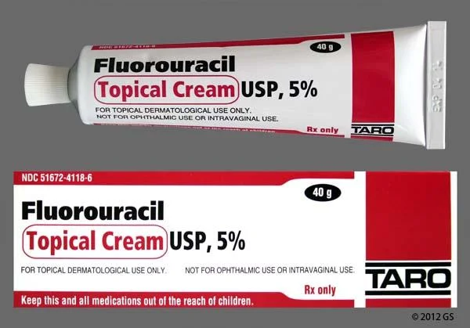
Treatment – skin creams & managing actinic keratoses
Local destructive therapy
Cryotherapy (freezing with liquid nitrogen)
Electrocautery and curettage
Filed therapy
Chemotherapy cream – Fluorouracil(5FU) or imiquimod
There is initial concerns of activating immune system and cause subsequent organ rejection with top imiquimod
Small trials suggest that it can be safely used if applied to small areas
Notes:
Initially, concerns over the induction of immune activation and subsequent organ rejection with topical imiquimod limited the use of this agent in the transplant population. However, the initial results of small, randomized trials suggesting that this agent can be used safely have been tempered by a single report of acute renal failure in a patient treated with imiquimod for viral warts to a surface area that may have exceeded that used to treat actinic keratosis [68]. In treating actinic keratosis, imiquimod is applied to limited areas (60 to 100 cm²) three times per week for up to 16 weeks

Slide 22
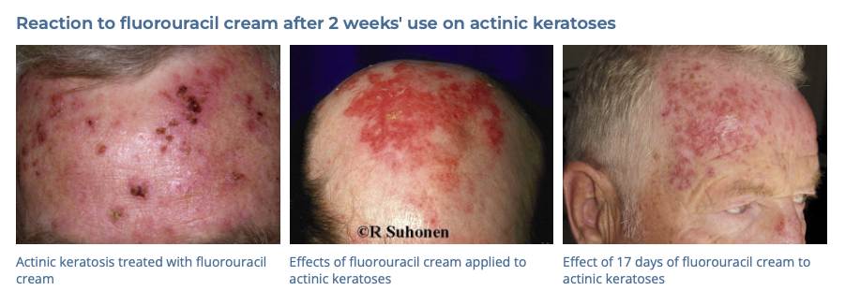
Treatment – skin creams & managing actinic keratoses – cont’
5FU cream
it is toxic to certain cancer and precancerous cells eg Aks
It can induce significant inflammation
Indications – AK, in situ squamous cell carcinoma
Treatment duration is usually 4-6 weeks.

Slide 23
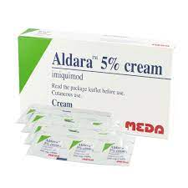
Treatment – skin creams & managing actinic keratoses – cont’
Imiquimod (Aldara)
immune response modifier
Indicated for AKs,BCC, intraepidermal SCC
First approved for genital warts
Similar to 5FU, the usage results in inflammation in order to destry the lesion
Dose is dependent on the type of lesions
Actinic keratosis – 2 -3x/ week for 4-6 weeks
BCCs and SCCIS – 5x a week for 6 weeks

Slide 24
Salient points
Skin cancer is more common in transplant patients, and it carries higher mortality.
Important to have regular skin checks post organ transplant.
Regular self skin examination.
SUN PROTECTION is important!!!!
Once skin cancer or pre-cancerous lesions are identified, they will require AGGRESSIVE TREATMENT.

Slide 25
References
Stasko,T., Hanlon, A,M.. Epidemiology and risk factors for skin cancer in solid organ transplant recipients. In: UpToDate, Robinson, J.K. (Ed), Corona, R. (Ed). UpToDate, Waltham, MA. Accessed on January 16, 2024.
Stasko,T., Hanlon, A,M.. Prevention and management of skin cancer in solid organ transplant recipients. In: UpToDate, Robinson, J.K. (Ed), Corona, R. (Ed). UpToDate, Waltham, MA. Accessed on January 16, 2024.
Ludgate, M. Skin cancer in transplant recipients. [Dermnet], (2005), https://dermnetnz.org/topics/skin-cancer-in-transplant-recipients#:~:text=Why%20are%20transplant%20patients%20at,cells%20to%20develop%20into%20cancers., accessed 16 January 2024.

Slide 26
Q & A

