Slide 1
World Transplant Games, Dresden 2025
Information
Session
# 5

Slide 2
Welcome
Introductions
Chris Thomas, CEO Transplant Australia
Marg Hill, Team Manager
Julie Scudds, Assistant Team Manager
Jo O'Farrell, Manager - Stakeholder Engagement
Women in Sport Panel
Petria Thomas OAM and Lisa Cuthbertson
Peta Jordan, Team Physio
Please put any questions you have during the meeting in the chat, and we will respond at the end of the presentation.

Slide 3
Acknowledgement of Country
Transplant Australia acknowledges the Traditional Owners of Country throughout Australia and acknowledges their continuing connection to land, waters and community. We pay our respects to elders past and present.

Slide 4
Agenda
A moment of reflection
Women in Sport Panel with Petria Thomas OAM and Lisa Cuthbertson
Preparing for the Games - Peta Jordan: Team Physio
Australian Team Requirements - Emmy O'Neill
Updates from Team Manager - Marg Hill
Media Updates - Jo O'Farrell

Slide 5
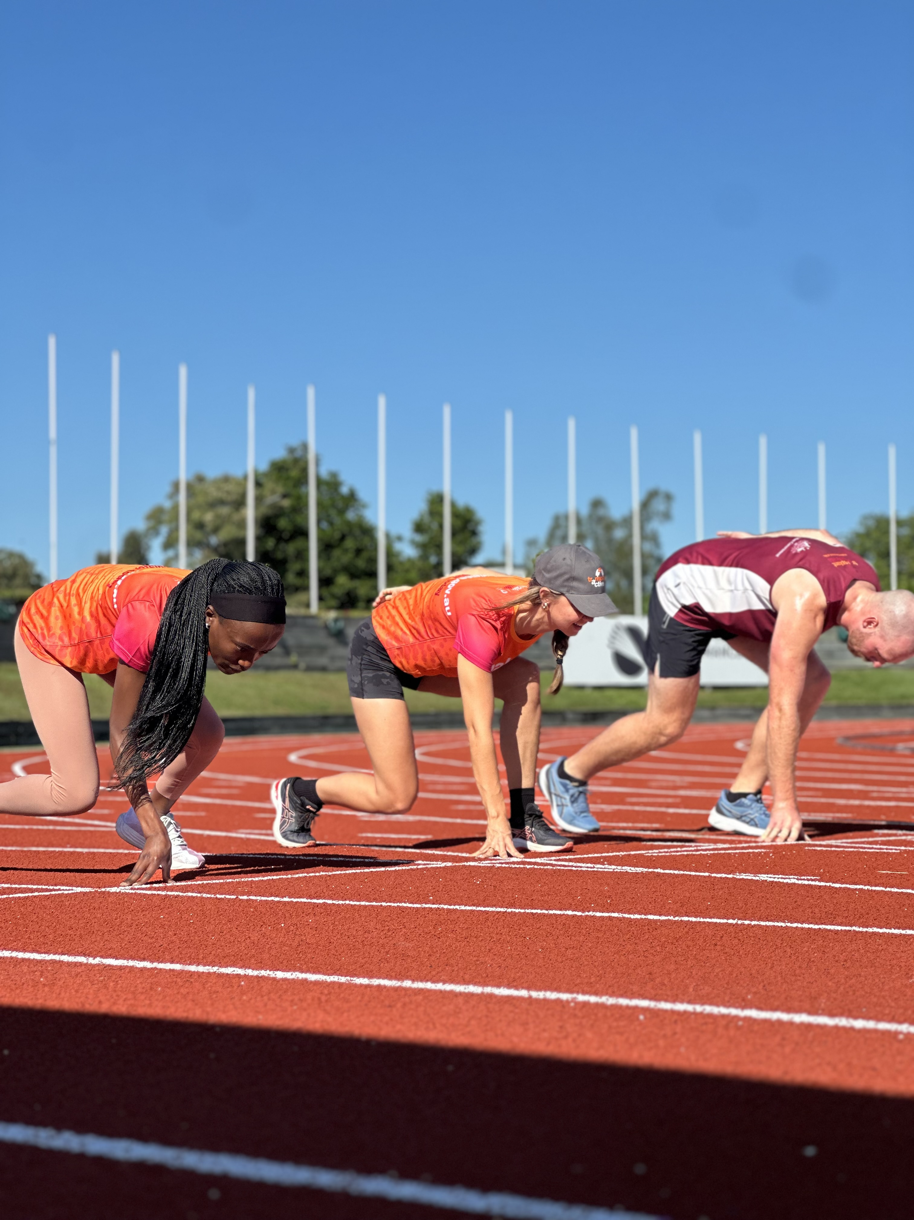
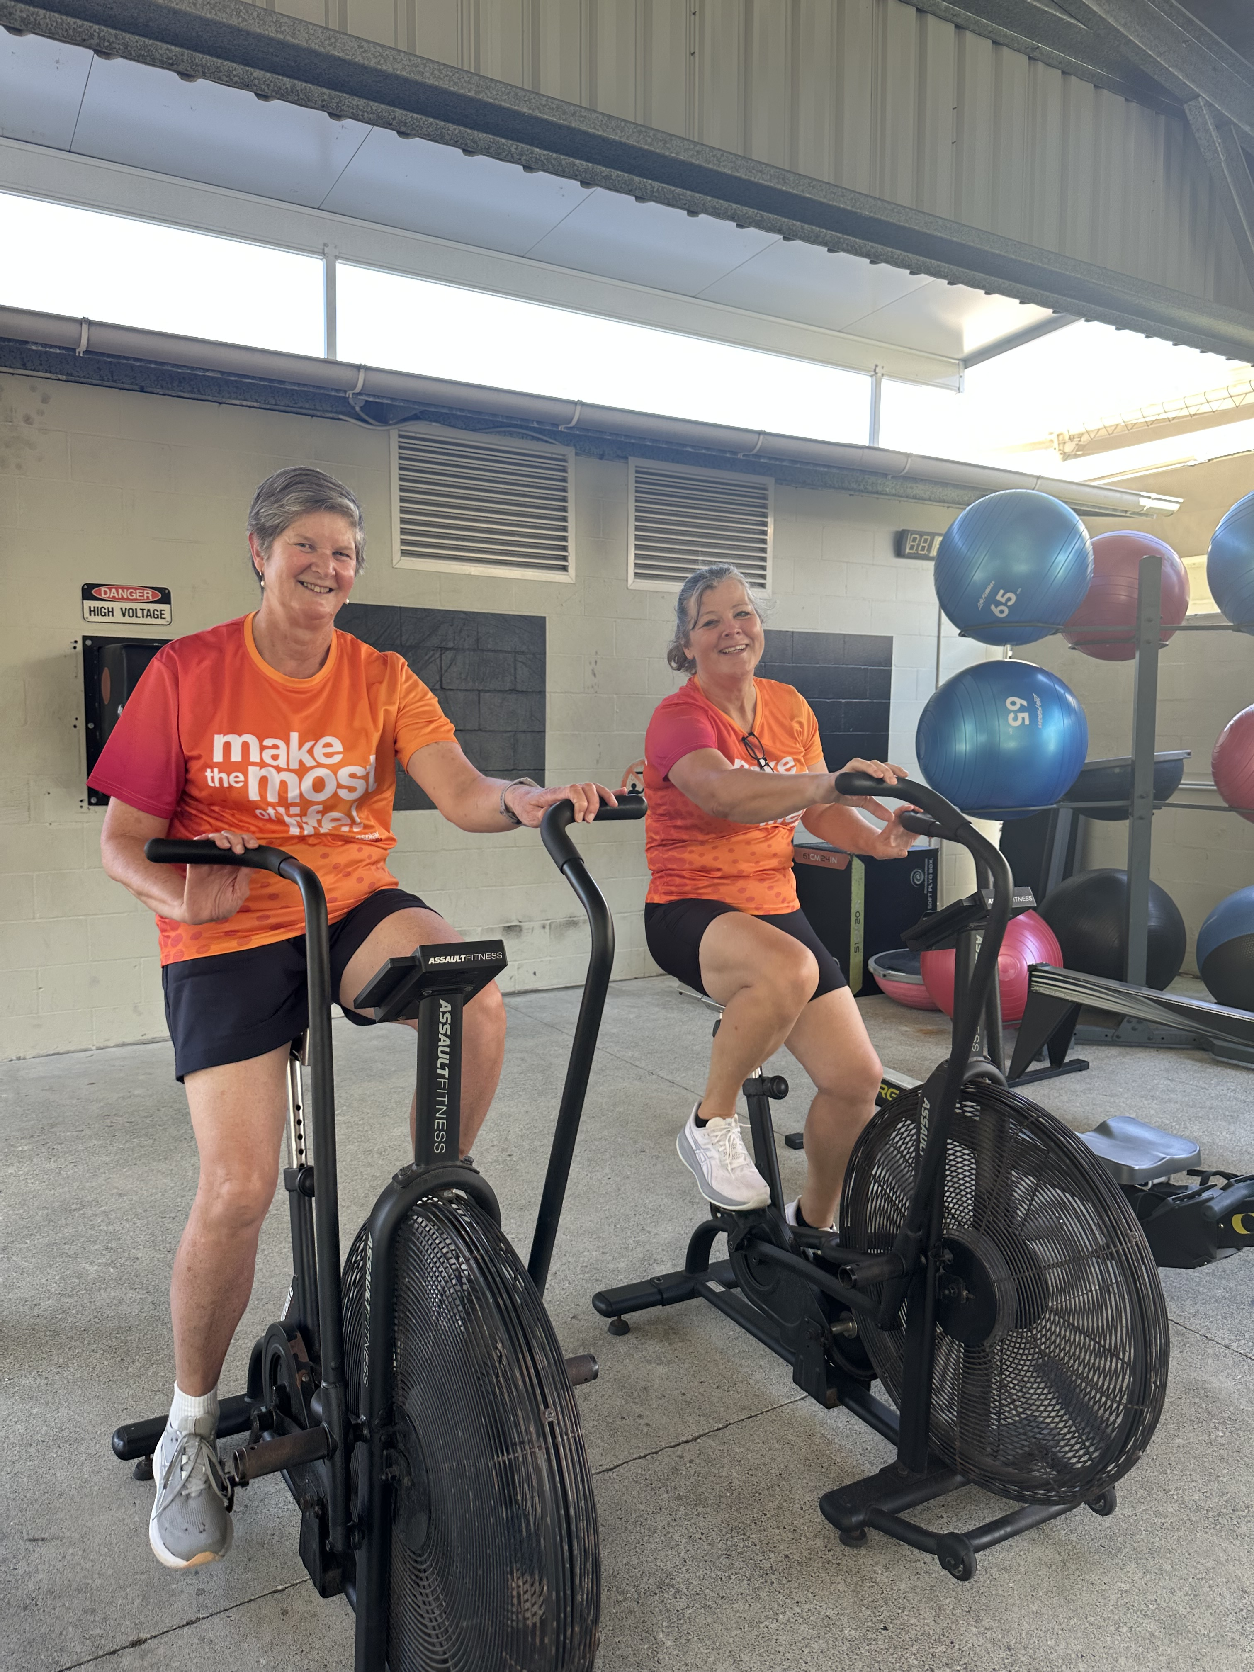
A moment for reflection

Slide 6
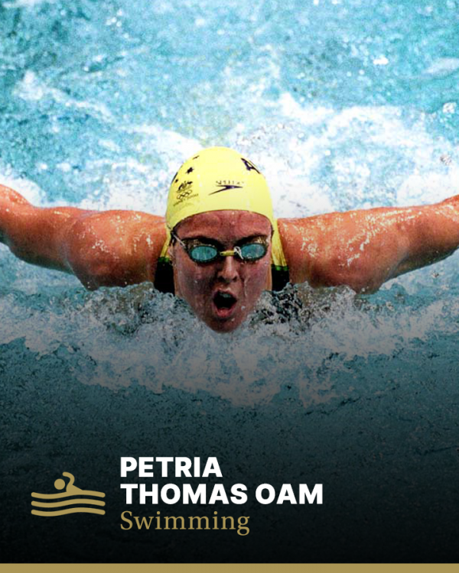
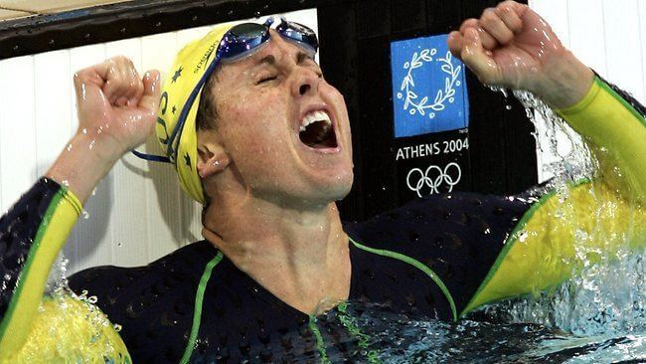
Special Guest – Petria Thomas OAM
Australian sporting icon who has provided joy and inspiration for many Australians through her sporting success, resilience and determination. Petria went on to win eight Olympic medals—including three golds—across three Games: Atlanta 1996, Sydney 2000, and Athens 2004.
Medical Certificates close
EVENT
Notes:
Swimmers include: One piece, swim briefs and trunks.
Volleyball and football

Slide 7
WTGF Hall of Fame – Lisa Cuthbertson
Lisa has attended an incredible total of 18 World Transplant Games, with her first being in Singapore 1989. Inducted into the WTGF Hall of Fame at the World Winter Games in Italy in 2024.

Slide 8
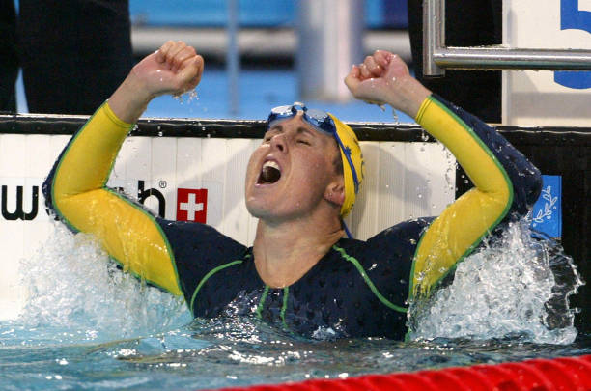
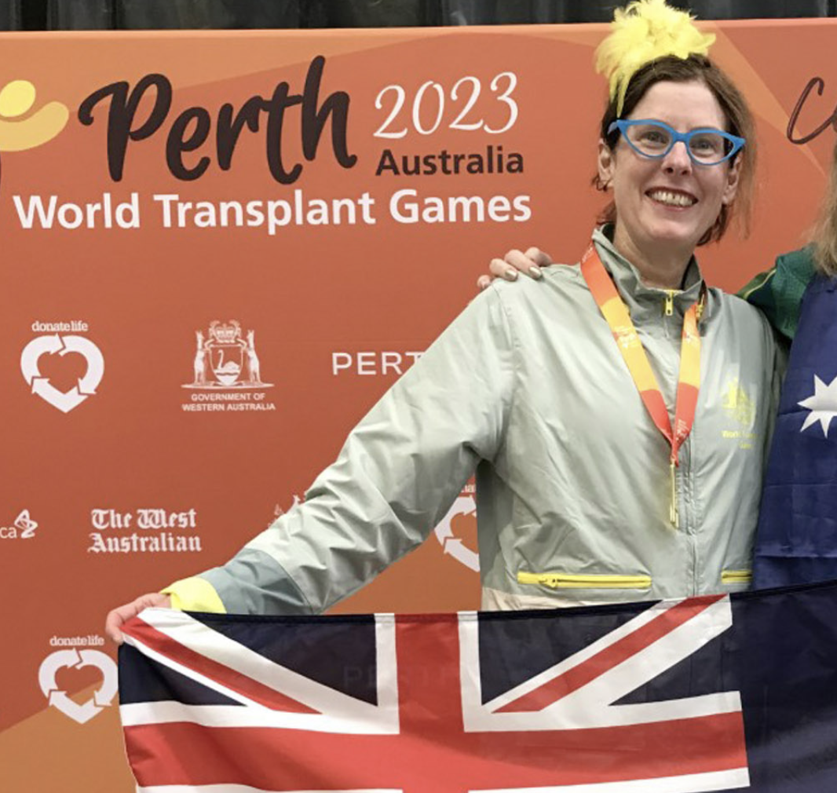
Women in Sport Panel

Slide 9
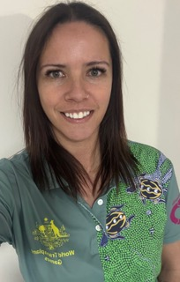
Team Physio – Peta Jordan
HOW CAN PHYSIO HELP
Injury advice, assessment and management
Preparation for events
Strapping
Post event management
EQUIPMENT
Strapping tape, massage gel, ice packs, basic first aid equipment

Slide 10
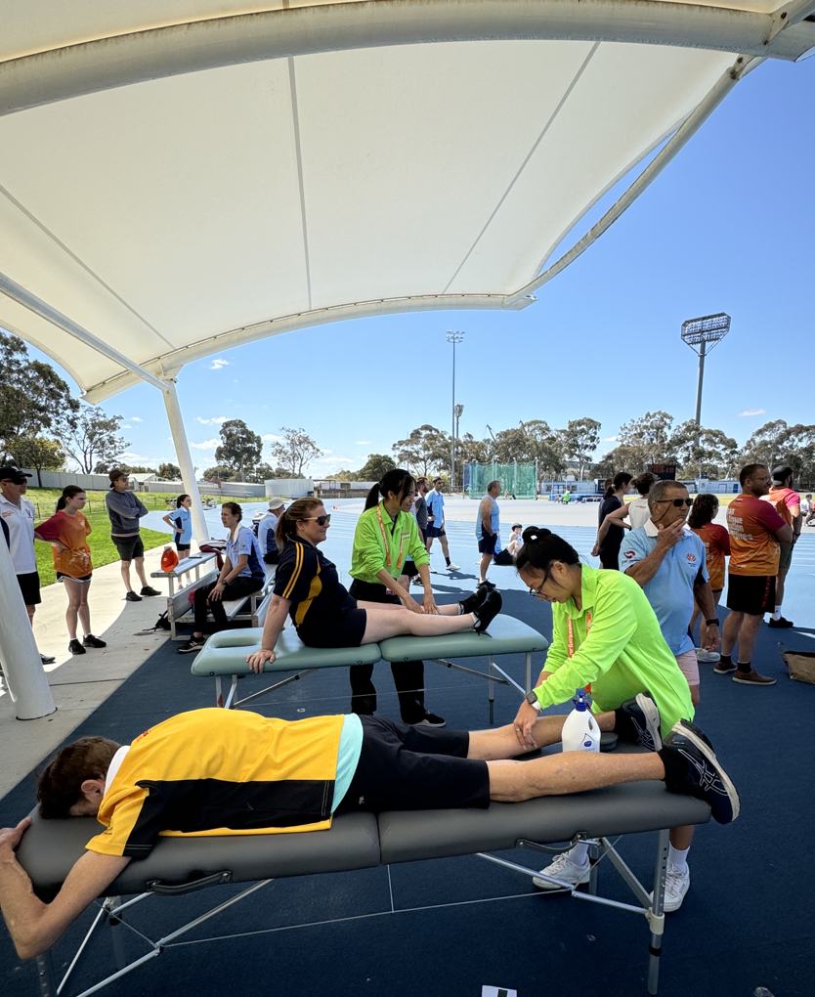
INJURY PREVENTION
Pre-existing injury preparation (tape, advice and management plan to get through the games)
Warm up AND stretch
Cool down AND stretch
Re-hydrate
Rest between events
Most likely “injury” to occur at these games is medical, dehydration and exhaustion. Winter to Summer climate change, time zone alteration, physical exertion. Temp in Dresden in August 11 - 27

Slide 11
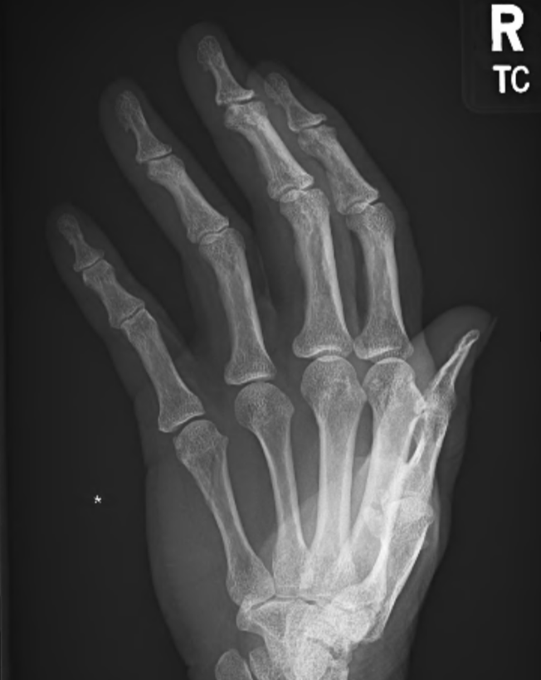
INJURY MANAGEMENT
R.I.C.E or P.R.I.C.E
Assessment of injury, advice on management plan and continued participation. Discuss primary event with athlete.
Follow up and assist in preparation for further events.
If minor injury - follow up with home physio on return from Europe.

Slide 12
BETWEEN EVENTS/END OF EACH DAY
Cool down and stretch
Rest
Rehydrate
Eat
Warm up before next event
MYTH BUSTING Alternating hot/cold is not recommended Cold - pain relief, reduce swelling <24 hours Heat - release tight muscles, promotes blood flow and healing >24 hours depending on swelling needs

Slide 13
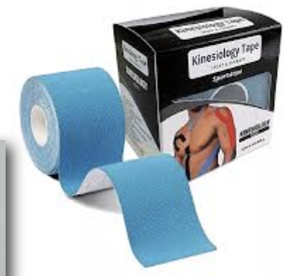
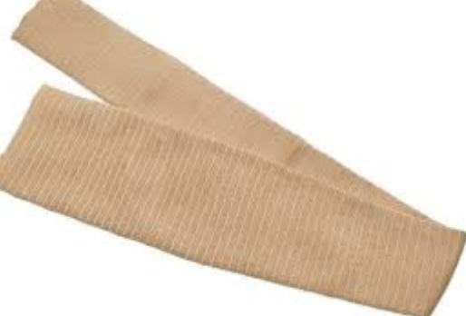
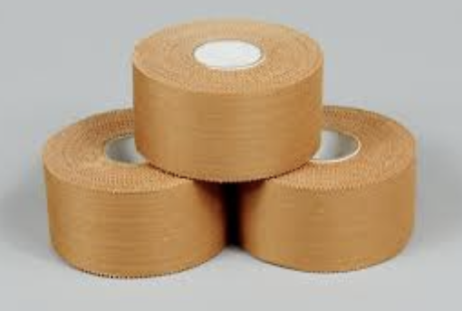
STRAPPING
Rigid tape for ligament injuries
K-tape for muscular injuries (calf muscles, hamstrings)
Compression wrap
Tubi-grip compression sleeves

Slide 14
MASSAGE
Pre event and mid event massage can only be light and fast, no deep pressure. Pre event or mid event massages are all about blood flow restoration and warming the muscles. Both can be achieved to the same benefit with a good warm up and stretch.
Good elbow digging deep tissue massage is best 3 days before event for optimal muscle recovery and readiness. MYTH BUSTING Pre event is massage is equally beneficial as a good warm up and stretch. Warm up and stretch is more beneficial in injury prevention.

Slide 15
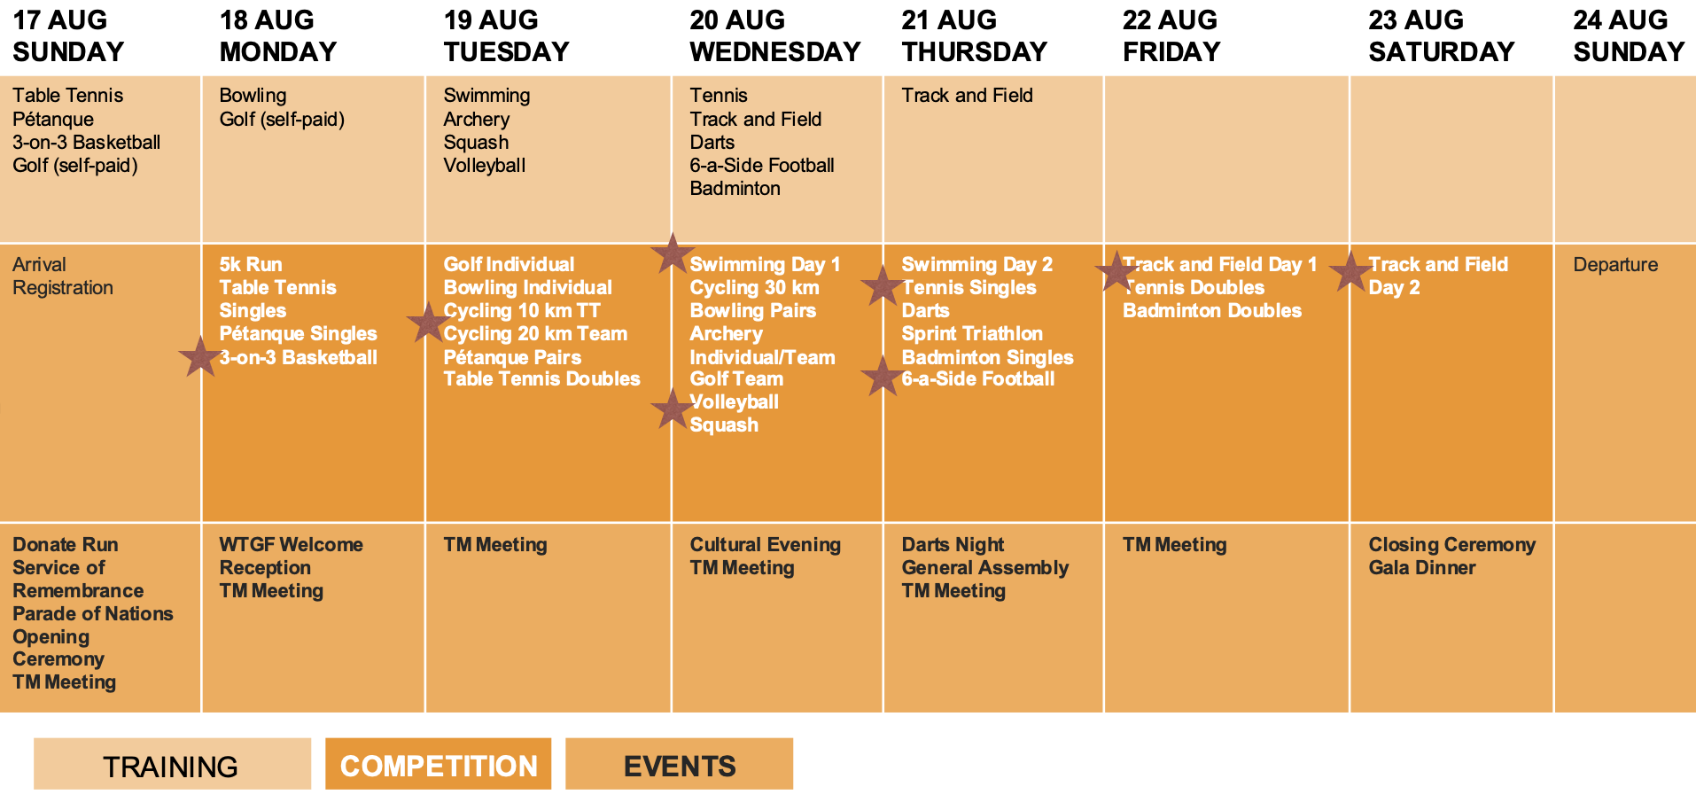
TIMETABLE
Sideline at higher risk events
Available in afternoons or on call for assessment if you can't find me sideline at your event and need assistance

Slide 16
CONTACT PETA
Pre-existing injuries (inform or advice)
Warm up advice for specific events
Assistance with strapping
Injury assessment and advice
Urgent review
petamarie18@gmail.com
0401 654 557

Slide 17
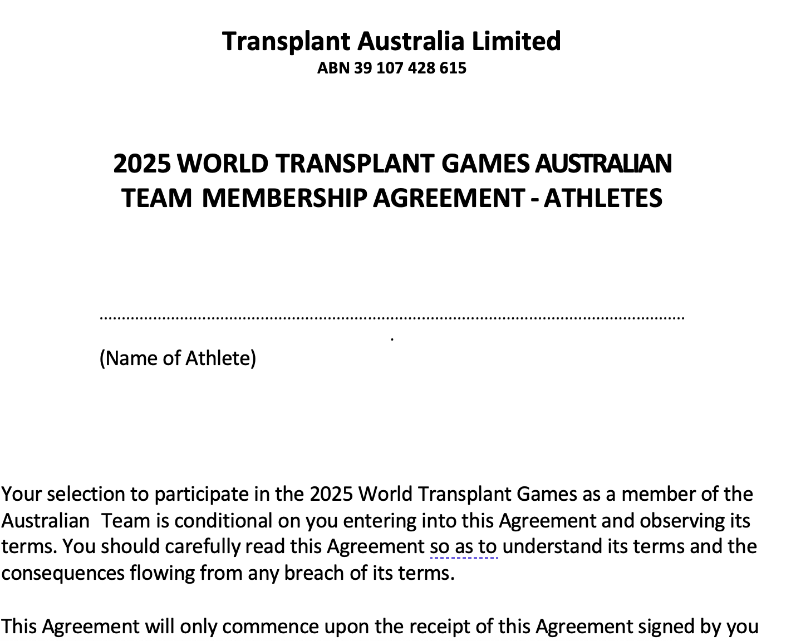
Australian Team Requirements
Athlete and Supporter Agreements
Transplant Australia will soon be sending agreements out to each athlete and supporter for completion.
These must be signed and returned to team manager before the games.
Transplant Australia Membership
You must also be a current financial member of Transplant Australia to compete in the World Transplant Games
Cost: Current membership (including state participation fee of $60/two yearly) of Transplant Australia – https://transplant.org.au/members/
Medical Certificates close
EVENT
Notes:
Swimmers include: One piece, swim briefs and trunks.
Volleyball and football

Slide 18
Australian Team Requirements
Transplant Australia Education Plan
All athletes representing Australia are required to complete online education modules from Sports Integrity Australia, including Anti-Doping and Child Safeguarding training
A detailed email will be sent to each athlete and supporter with instructions how to complete these online modules, which must be done prior to attending the World Transplant Games
*Please note this is mandatory under our recognition guidelines
Notes:
Swimmers include: One piece, swim briefs and trunks.
Volleyball and football

Slide 19
Medication Reminders
Reminder to check Smart Traveller / DFAT
Remember you need scripts and full boxes of medications, particularly when flying through Asia or Middle East
Letter from your specialist / doctor
Tip - Flatten boxes (carry with) to take up less space.

Slide 20
Team Manager Updates
Arrival dates into Dresden
Send signed Athlete /Supporter Agreement.
Ten sets of boules to borrow (first in first serve).
Team Dinner Date: Saturday, 16th August 2025
Extra nights of accommodation

Slide 21
Cancellation Policies
Hotel Cancellation Policy
2nd June – 3rd July, 2025: 30% refund
From 4th July, 2025: no refund
Registration Cancellation Policy
2nd June – 3rd July, 2025: 100 refund PLUS 178,50 EUR handling fee (incl. 19% German VAT)
From 4th July, 2025: no refund
Medical Cancellations For medical cancellations after 1 June, refund requests will be assessed on a case-by-case basis by the Local Organizing Committee (LOC).

Slide 22
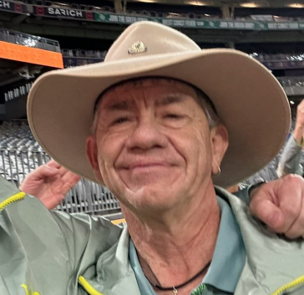
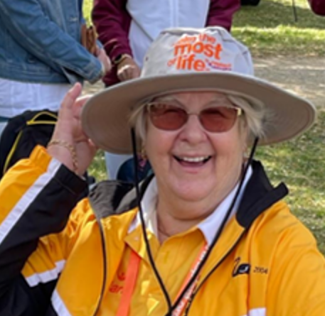
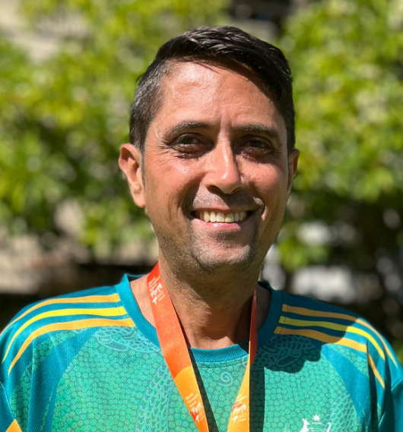
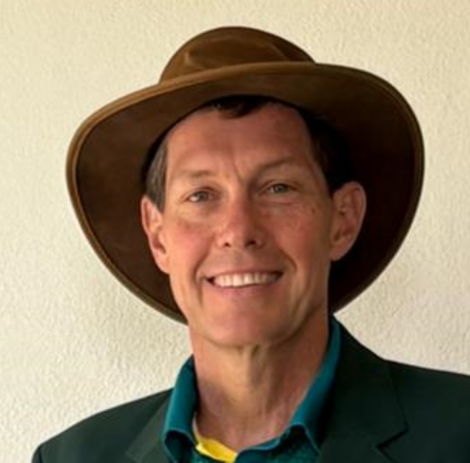
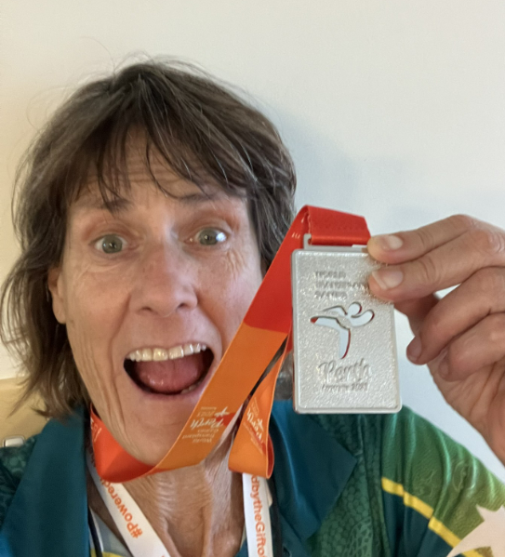
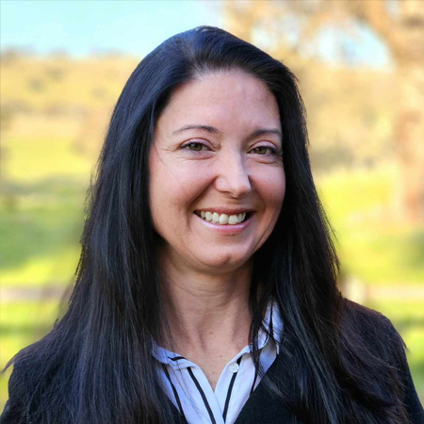
Team Captains
5km Run and Athletics – Kate Clark
Basketball – Jane Yates (Coach)
Cycling and Triathlon – Troy Scudds
Football – Matthew Heyburgh
Darts and Pétanque – Glenda Rayment
Swimming – Lisa Cuthbertson
Ten Pin Bowling – Mick Kennedy
Volleyball – Clayton Walton

Slide 23
Medical & Insurance Reminder
Travel insurance is compulsory for all games registrants - It is your responsibility to ensure you have adequate cover. There are various options for Australian Travel Insurance Companies – please make sure repatriation and competitive sports are included in your travel insurance policy, as Germany do not have reciprocal health arrangements with Australia. Most travel insurance do not cover competitive sports.
Travel Health and Repatriation Insurance (Provided by Germany) is an option for registrants at 3.92 EUROS pp/pd within all Schengen Countries, however this does not include coverage of flights or lost luggage etc. This ONLY covers medical and repatriation costs. If you have paid for Dresden medical/repatriation insurance, please read terms and conditions on the website and print off. Only section A of the T&C applies.
Any new health issues this year must be reported to WTGF medical officer - Dr. Paul Harden paul.harden@ouh.nhs.uk
For those who have taken up the WTG insurance – If you have a medical issue or injury:
When in Germany -all out of hospital care will be changed directly to you, and you must keep receipts to claim back through the WTG insurance.
Hospital admission – you must notify the insurance company as soon as possible, for them to pay the hospital direct.

Slide 24
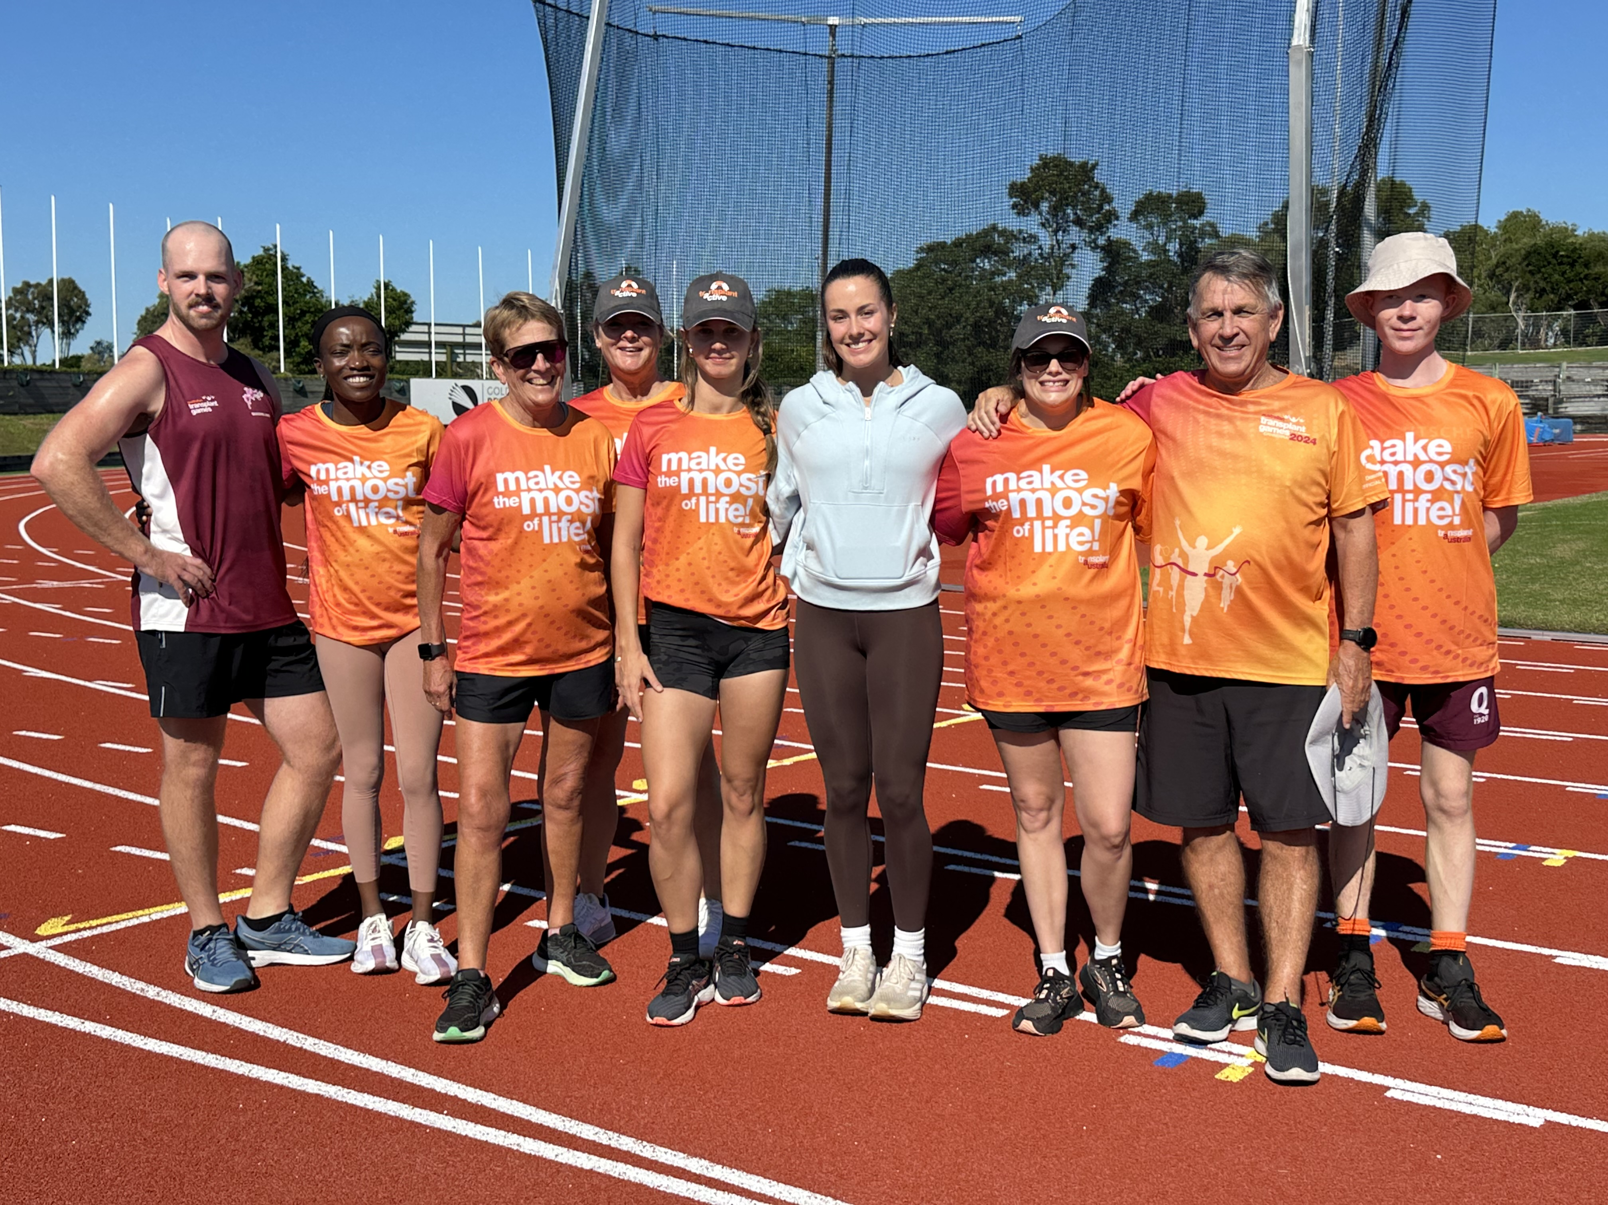
Social Media – Team Australia@WTG
We want to showcase your journey getting to the games!
Whether that is attending sports weekends, going to the gym or hitting the court, swimming pool or track with some friends.
Please send through photos & videos of you training for the games, so we can showcase your journey to the community, media and the World Transplant Games.
Please send through videos & photos
to: media@transplant.org.au
PS We especially love video! And where possible
portrait over landscape!

Slide 25
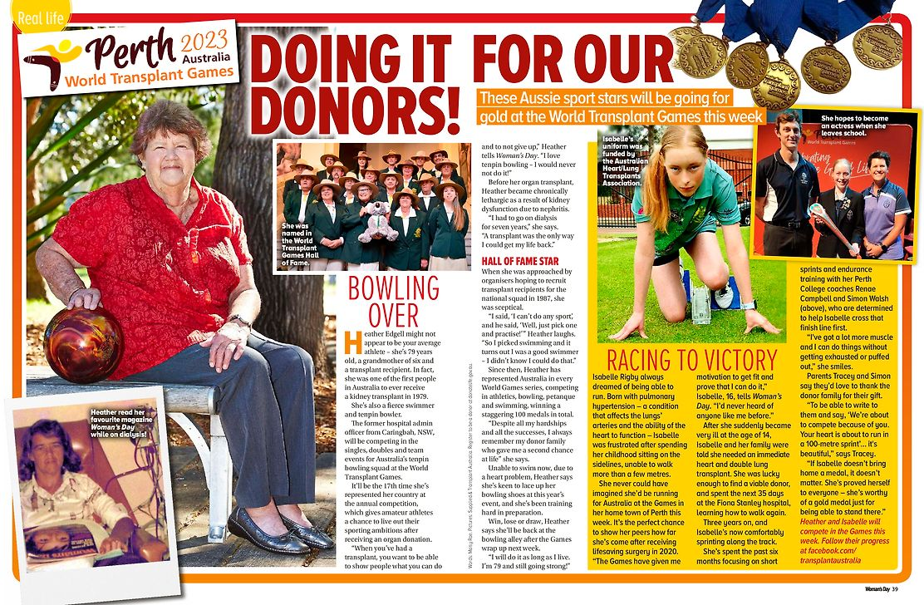
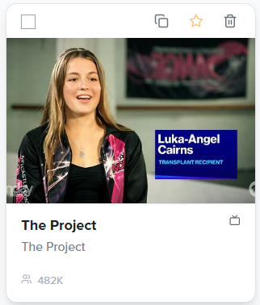
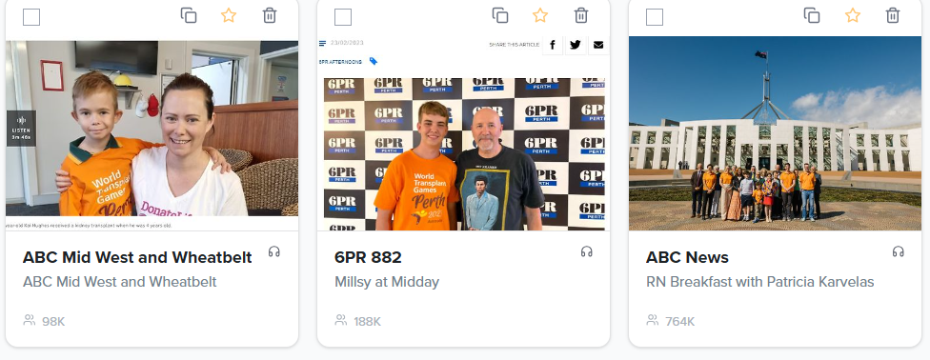
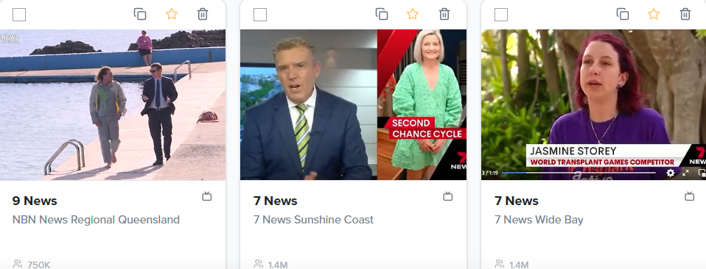
Media – be the inspiration!
Inspire more Australians to register as an organ and tissue donor and share that decision with their family.
Join our Athlete Media Program – share your story with Transplant Australia, and we will promote your story to local and national media. We’ll support you every step of the way.
If you receive media enquiries, please get in touch so we can support you and provide approved DonateLife messaging.
Enquiries: media@transplant.org.au
Please fill out this athlete media form to share your story: here

Slide 26
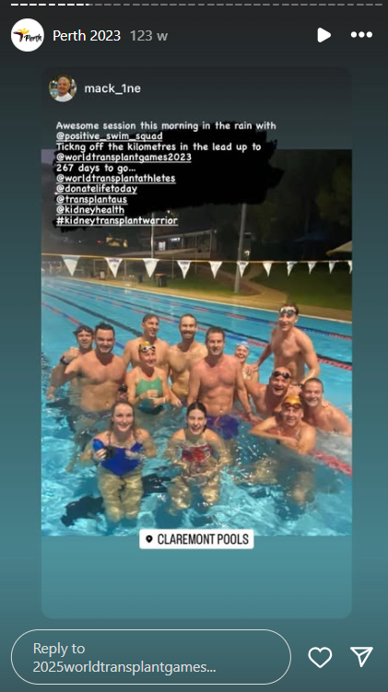
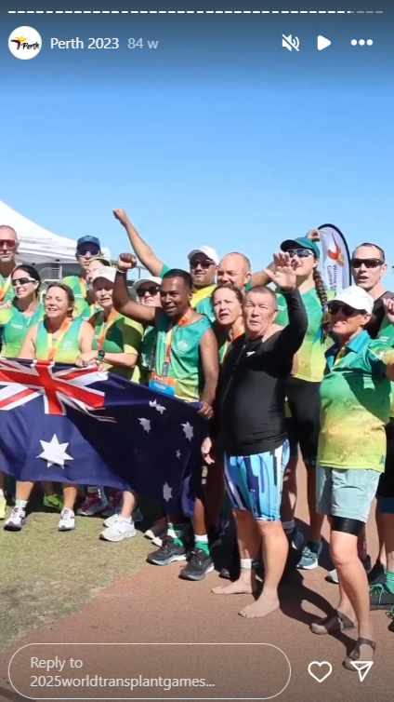
Social Media – be the inspiration!
Many reasons to share your journey on social media – Making memories. Inspiring organ and tissue donation awareness. Motivating your teammates. Supporting your fundraising. Giving hope to others on the transplant journey.
Tag Transplant Australia and World Transplant Games in your training and preparation.
Facebook @transplantaustralia @officialworldtransplantgames
Instagram @transplantaus @2025worldtransplantgames
Tags: #DonateLife #WTG2025 #ReasonToGive #TransplantAustralia
Social Media Volunteer Wanted! If you love taking photos/video and creating social media content, help Transplant Australia cover the action and excitement of Team Australia on the ground in Dresden.
Enquiries: media@transplant.org.au

Slide 27
Uniforms Reminders
Uniform orders have now closed.
You should be getting your uniforms delivered within the next few weeks, if you haven’t already received them.
Cycling/triathlon – production has now commenced, and uniforms will be dispatched directly from Pedal Mafia to your home.
Swimming – Our order has commenced production and will be sent to WA once complete – You can collect from Julie Scudds in WA or in Dresden. (includes swim caps)
All other items are on their way or already delivered!
Parade Uniform
To complete your uniform for the opening ceremony, please arrange the following :
Akubra Style Hat
Bone coloured moleskin/chinos/skirt
Comfortable shoes for walking
Uniform FAQ at transplant.org.au/world-Australia-team/ provides links and examples for these items.

Slide 28
Australian Team - Fundraising
Transplant Australia Fundraising Guidelines
Submit Fundraising Application
Online Fundraising through Raisely
Link: https://world-transplant-games-australia.raiselysite.com/
Fundraising enquiries to: Julie.Edwards@transplant.org.au
Transplant Australia website - Team Australia page: https://transplant.org.au/world-australian-team/
Notes:
Accommodation – Full payment due by March 17

Slide 29
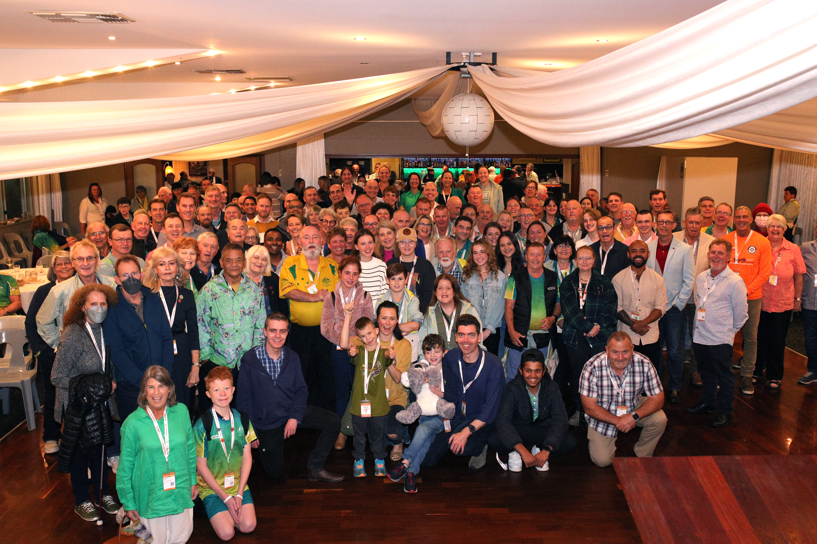
Stay Connected
WHATSAPP GROUP ANNOUNCEMENTS
We have an Australian Team WTG Announcements group running – If you have not been added to the group yet, please email julie.scudds@transplant.org.au with your phone number for inclusion.
ALL TEAM ANNOUNCEMENTS DURING THE GAMES WILL BE POSTED IN THIS GROUP ONLY
Medical Certificates close
EVENT
TEAM AUS WHATSAPP GROUP CHAT
We have now set up a Team Australia Chat for those people who
would like to join for respectful communication and connection
with your fellow teammates.
Please note we will not automatically add your name to this chat, as some people may not wish to be involved.
You can click on the link at right to add yourself, or alternatively you can join when the link is emailed to you.
Please ensure you have read and acknowledge Transplant Australia’s Social Media Policy found on our website at transplant.org.au/members
Group Chat Link: https://chat.whatsapp.com/C3YitG4bsC19EkzrsoYZ0R
Notes:
Swimmers include: One piece, swim briefs and trunks.
Volleyball and football

Slide 30
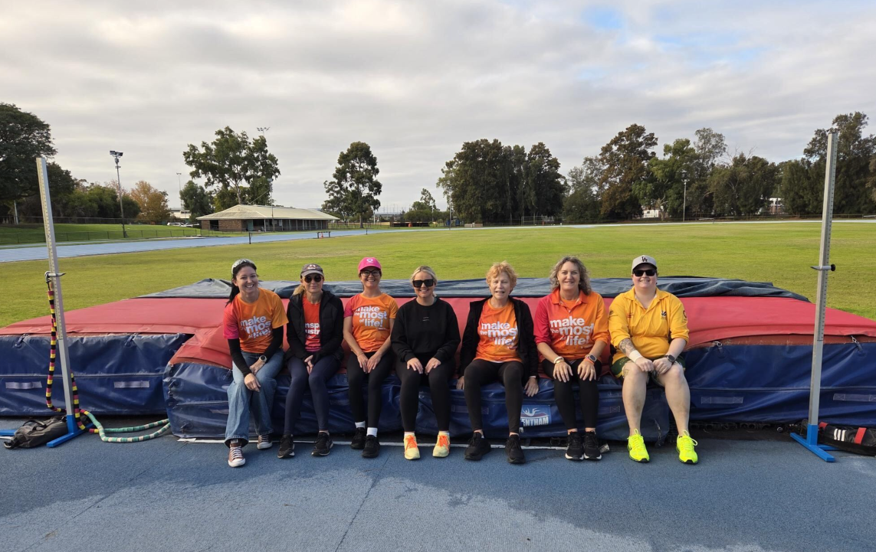
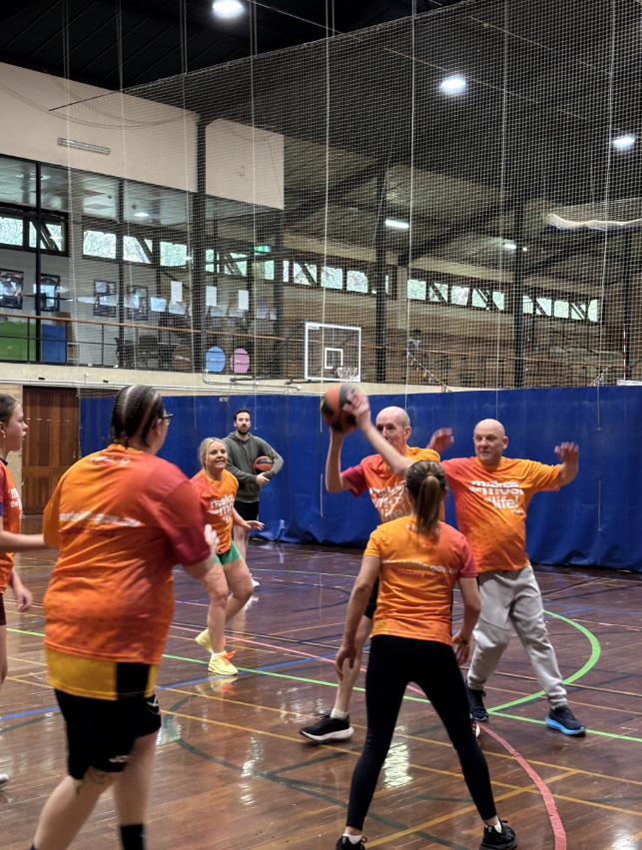
Preparing for the games:
Want to get some training in and meet your fellow
teammates before heading to Dresden? Multiple states
are hosting sports camps!
ACT: TSANZ Fun Run – Sunday 22nd June
NSW: Berry Camp - Fri 27th – Sun 29th June
QLD: Sunshine Coast Sport and Community Day - Sunday 6th July
WA: Sports Training Weekend & WTG Farewell - Sat2nd - Sun 3rd August
QLD: Brisbane Sport and Community Day - Sunday 10th August
To find out what's happening in your state, check out your dedicated state page on our website: https://transplant.org.au/

Slide 31
Getting around Dresden
If you would like to know more about getting around Dresden, and the location of all the sights and sporting venues, the Dresden App from Dresden Tourism is very good
This App includes all the public transport links and live wait times, so will be invaluable during games week.
It's very easy to use and is free to download.
To Download, go to : https://www.dresden.de/en/tourism/information/dresden-app.php

Slide 32
Team Australia Song
To be sung to “I am Australian” by The Seeker (the Chorus) 1:10 – 1:36 on this clip]
We are strong
And we are driven
By the force of donors near and far
We will fight
And never give in
We are, proud-ly
Team Austra-li-a.
Lyrics by Shannon Cuthbertson,
Sister of Lisa who received her bone marrow in 1985.

Slide 33
Q & A
If you have any final questions, please ask in the meeting chat,
and we will endeavour to answer you now.

Slide 34
Further Information:
Team Manager, Margaret Hill – Team.Manager@transplant.org.au
General Queries & Sports – Sports@transplant.org.au
Fundraising - Julie.Edwards@transplant.org.au
Media – Jo O'Farrell - media@transplant.org.au
Visit Games Website – https://wtg2025.com
Visit Team Australia website – https://transplant.org.au/world-australian-team/

Slide 35
Final Team Webinar:
Next Team Meeting:
Webinar 6
Date: Tuesday 29th July (AEST – 7.00pm, AWST – 5.00pm)
Special Guest – Lucinda Barry, CEO Organ and Tissue Authority
Packing Tips and Final Messages from Marg Hill, Team Manager

